Slide 1

Unlocking the Power of Natural Language Processing (Computational Linguistics)
Welcome to an introduction to NLP! From understanding human language to automating text generation, we’ll explore the exciting landscape of computational linguistics.

Slide 2
The Art and Science of NLP
1
2
3
4
Introduction to NLP
Defining Computational Linguistics
The Role of Linguistics
Components of Language
Computational techniques for processing and analyzing human language.
Linguistics provides foundational theories and models used to build NLP systems.
Lexical, syntactic, semantic, and pragmatic components work together to convey meaning.
A field at the intersection of computer science, linguistics, and artificial intelligence.

Slide 3
Introduction to NLP
NLP stands at the intersection of linguistics, computer science, and artificial intelligence.
It enables machines to understand, interpret, and respond to human language.
NLP's applications range from chatbots and language translation to sentiment analysis and content generation.

Slide 4
Defining Computational Linguistics
Computational Linguistics combines linguistic theories with computational methods.
It involves developing algorithms for automating language analysis, processing, and generation.
This field bridges the gap between human language and machines, enabling meaningful interactions.

Slide 5
Role of Linguistics
Semantic Understanding: Linguistic insights enable NLP models to comprehend word meanings, nuances, and contextual subtleties, enhancing accurate interpretation of text.
Syntax Analysis: Linguistic theories guide NLP systems in structurally analyzing sentences, identifying grammatical components, and understanding relationships between words.
Named Entity Recognition (NER): Linguistic patterns assist NER algorithms in identifying and categorizing entities like names, dates, and locations, aiding in information extraction.

Slide 6
Components of Natural Language
Human language comprises various components, including syntax (sentence structure), semantics (meaning), morphology (word forms), and phonetics (speech sounds).
NLP algorithms must decipher each of these components to comprehend and generate language accurately.

Slide 7
Benefits of Computational Linguistics
Efficient Language Processing: Computational linguistics streamlines the analysis, understanding, and generation of human language, enhancing the efficiency of various tasks.
Improved Communication: It bridges language barriers, enabling seamless communication between individuals speaking different languages.
Enhanced Data Insights: Computational linguistics extracts valuable insights from textual data, supporting informed decision-making.
Innovation and Automation: By automating language-related tasks, it paves the way for innovative applications such as chatbots, sentiment analysis, and content generation.

Slide 8
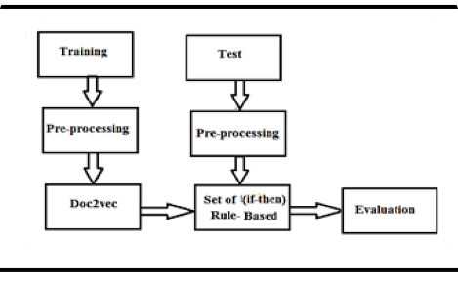
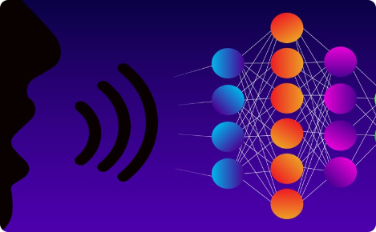
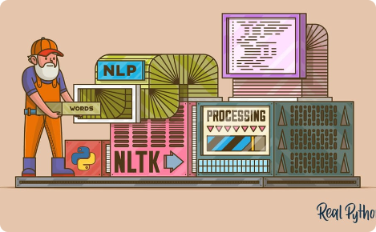
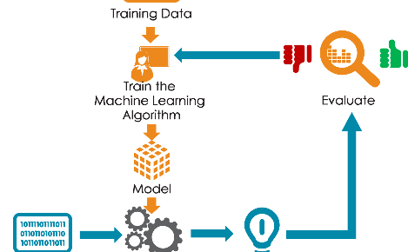
The Evolution of NLP
Rule-based NLP
Deep Learning NLP
Early systems relied on hand-coded rules for language processing.
Modern machine learning techniques enable automated language processing through neural networks.
NLP Toolkits
End-to-End NLP Pipelines
Toolkits such as NLTK and spaCy enable researchers to build and test NLP systems.
Combining multiple language processing tasks into a single pipeline has enabled more advanced NLP applications.

Slide 9
Applications of NLP
Sentiment Analysis
Language Translation
Understand emotions and opinions expressed in natural language text.
Automatically translate between languages using sophisticated machine learning algorithms.
Named Entity Recognition
Deep Learning for NLP
Extract and classify named entities, such as people, places, and organizations from text.
Advancements in deep learning have enabled more advanced NLP applications, from chatbots to automated text generation.

Slide 10
The Future of NLP
1
Trends and Innovations
Advancements in language models, end-to-end pipelines, and ethical considerations will shape the future of NLP.
2
Ethical Considerations
Ensuring fairness and avoiding bias in NLP applications will be critical as the technology expands.
3
Multilingual NLP
Challenges in cross-lingual transfer learning and developing systems that can handle multiple languages.
4
NLP Applications
Opportunities for NLP in healthcare, customer service, business insights, and content creation.

Slide 11
Trends and Innovation in NLP
Semantic Understanding: Linguistic insights enable NLP models to comprehend word meanings, nuances, and contextual subtleties, enhancing accurate interpretation of text.
Syntax Analysis: Linguistic theories guide NLP systems in structurally analyzing sentences, identifying grammatical components, and understanding relationships between words.
Named Entity Recognition (NER): Linguistic patterns assist NER algorithms in identifying and categorizing entities like names, dates, and locations, aiding in information extraction.

Slide 12
Ethical Consideration
Bias and Fairness: Ethical concerns center around addressing bias in AI models that can perpetuate stereotypes or discrimination, aiming for fair and equitable language processing.
Privacy Concerns: NLP systems dealing with sensitive user data must prioritize data privacy, safeguarding personal information and adhering to data protection regulations.
Misinformation and Manipulation: The potential for AI-generated content to spread misinformation or manipulate public opinion raises questions about responsible content creation and dissemination.
Transparency and Accountability: Ethical NLP involves making AI-generated outputs transparent, understandable, and traceable, ensuring accountability for the generated content.

Slide 13
Multilingual NLP
Global Communication: Multilingual NLP enables seamless communication across language barriers, fostering connections and collaborations on a global scale.
Localization of Content: Businesses can use multilingual NLP to adapt content for different markets, improving user engagement and expanding their reach.
Cultural Sensitivity: Multilingual models must consider cultural nuances and context, ensuring accurate and respectful language processing across diverse languages.
Cross-Lingual Understanding: Multilingual NLP advances enable machines to understand and generate text in multiple languages, contributing to cross-lingual information retrieval and translation.

Slide 14
NLP Applications
Virtual Assistants: NLP powers voice-activated virtual assistants like Siri and Alexa, enhancing user interactions and providing information and assistance.
Language Translation: NLP-based translation tools break language barriers by enabling accurate and quick translations between different languages.
Sentiment Analysis: Businesses utilize sentiment analysis to gauge public opinions, monitor brand perception, and make data-driven decisions.
Chatbots and Customer Support: NLP-driven chatbots provide automated customer support, addressing user queries and offering solutions.

Slide 15

Summary and Conclusion
1
NLP is the Future
2
Ethics Matter
The ability to process, interpret, and generate human language will revolutionize the way we live, work, and communicate.
Building ethical NLP systems requires careful attention to issues of bias, fairness, and privacy.
3
Let's Create Together
Join the exciting journey of computational linguistics and shape the future of NLP.

